Slide 1
Cadette’s Cybersecurity Basics Badge
Led by ….

Slide 2
Lead Presenter
Picture and Short Biography

Slide 3
Co-Host 1
Co-Host 2
Insert Photo and Short Biography
Insert Photo and Short Biography

Slide 4
Content Slides
01
Activity
02
Quiz
03
Questions
04
Learn the concepts and definitions.
Participate in an activity to better understand the concepts!
Join a Kahoot! Quiz to test you on your knowledge so far.
Ask some questions at the end by putting them in the chat!
Notes:
Layout of the Session--6 sections in total
Try to keep your microphone muted during the session!
If you have a question, type it in the chat and I’ll answer or ask you to unmute yourself!
If the audio and video quality is bad, try turning off your video to see if it will help!

Slide 5
What is cybersecurity?

Slide 6


Slide 7


What do you think of when you see hackers?
Notes:
White hat hackers - white hat hackers can sometimes be paid employees or contractors working for companies as security specialists that attempt to find security holes via hacking.
Black hat hackers - motivation is usually for personal or financial gain, but they can also be involved in cyber espionage, protest or perhaps are just addicted to the thrill of cybercrime
Hacktivists - use hacking as a form of civil disobedience to promote a political agenda or social change.

Slide 8

Our Goal
Notes:
In reality there are many places in security from researchers to hackers and they don’t all look like a man in his basement coding. Our goal is for you to see the different people who work in security. On the left is Amanda Rousseau, a famous malware researcher known as Malware Unicorn and [insert photo of other security folks].

Slide 9
What are careers like in cybersecurity?
Security Engineer
Security Analyst
Security/Threat Researcher
Security Compliance
Security Risk
Technical Program Manager
Data Scientist

Slide 10
Cracking a Code
Notes:
Nadin’s Section

Slide 11
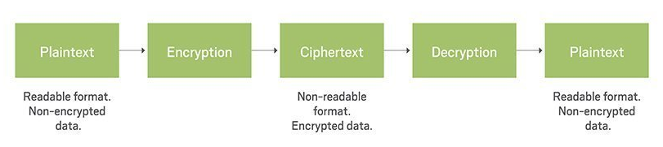
What is cryptography and why is it needed?
Cryptography is “practice and study of techniques for secure communication.”
It allows us to protect sensitive information and provide privacy to users.

Slide 12
Encryption
Encryption takes readable data and changes it so that it appears random.
Encryption requires the use of an encryption key: a huge number that both the sender and the recipient of an encrypted message know.
Truly secure encryption will be complex enough that a third party is highly unlikely to decrypt the ciphertext by brute force – in other words, by guessing.
Key
Readable Data (plaintext)
Secret Message (ciphertext)
Encryption

Slide 13
Decryption
Decryption allows for the recipient to take seemingly random strings of data and the known key to return the message into readable text.
When data is encrypted, it must then be decrypted before we can understand it.
Key
Secret Message (ciphertext)
Readable Data (plaintext)
Decryption

Slide 14


Slide 15

Let’s hide a message!
“Anyone can be in security” + key: 14
→ Mzkazq omz nq uz eqogdufk
Go to the online Caesar Cipher and choose a message to encrypt. Once you have, drop it the chat box and let others try to decrypt it!
Notes:
Use an online Caesar Shift Cipher to hide a message. https://www.xarg.org/tools/caesar-cipher/
Backup https://cryptii.com/pipes/caesar-cipher

Slide 16
Kahoot! Quiz

Slide 17
Hack a Password

Slide 18
How do passwords work?
When you create a password it is put through a hashing function to create a hash that is repeatable and hard to reverse.
When a user logs in they enter their password again on the site.
That entered password is run through the same hashing function as was used before.
The server checks this hash against the one stored for the user in the database.
If the two hashes match exactly the user is granted access.
Notes:
Because the functions themselves are well known, password hackers can easily calculate hashes for known words and other commonly chosen combinations in advance, and then match the cracked passwords up against these dictionaries. These dictionaries go far beyond simple words and include prefixes, suffixes, the practice of changing letters for numbers (e.g. 1 instead of l), and much more. This means weak passwords are broken very quickly, without the need for trial and error.
Describe that when an attacker gains your password, if you use it on other sites they can break into many accounts--don’t reuse passwords.

Slide 19
Come up with a password!
It must be between 6-12 characters.
Think of a new one! Do not choose one you use yourself.
When you know it, type it into the comments section.

Slide 20
Let’s Discuss!

Slide 21
Creating a Secure Password
At least 12 characters
Seemingly random
Uses a combination of uppercase and lowercase letters, numbers, and symbols.
For example: Think of a phrase that only makes sense to you; then add characters and symbols.
Notes:
If you want to have strong security you need to:
Create a long, and seemingly random password.
Change that password periodically.
Not re-use that password on other websites.

Slide 22
Let’s Try Again!
Use the password best practices to come up with a new password!
Submit it in the comments section.

Slide 23
Let’s Discuss!

Slide 24
Types of Attacks
Brute Force Attack: consists of an attacker submitting many passwords or passphrases with the hope of eventually guessing correctly. (i.e. they don’t know your password but they’ll guess until they figure it out)
Dictionary Attack: a type of Brute Force attack that systematically enters every word in a dictionary as a password.
Reverse Brute Force Attack: when a username and password pairing is known by the attacker, they can use this information to gain access to multiple other websites/accounts where it’s been reused.
Notes:
Utilizing strong passwords, allowing a limited number of login attempts and enabling two-factor authentication can help to prevent brute force attacks.

Slide 25
Kahoot! Quiz

Slide 26
Understand Two Factor Authentication
Notes:
David’s Section!

Slide 27
What is two factor authentication (2FA)?
When you are proving it’s you, there are three ways:
Know – PINs (Personal Identification Numbers), passwords, and answers to security questions
Have – Mobile phones, smart cards, physical tokens, and bank cards
Are – Biometrics such as fingerprints, retina scans, facial recognition, and voice recognition.
Notes:
Two-factor means the system is using two of these options.

Slide 28
So, why use 2FA?
You’re Only as Secure as the Weakest Link
90% of passwords can be guessed in under 6 hours
65% of people use the same password everywhere
Only 10% of Google users have 2FA enabled.
Notes:
Let’s say I figure out your password is your dog’s name and your mom’s birthday. What would stop me from logging into your Facebook, Instagram, Twitter, and email and locking you out? Hopefully, it’s because I do not have the second factor!

Slide 29
Let’s enable 2FA on Facebook
Notes:
Use a dummy account for this with Julie to show limitations of knowing a password

Slide 30
Kahoot! Quiz

Slide 31
Explore Social Engineering

Slide 32
What is social engineering?
Social engineering is the manipulation of people into performing actions or divulging confidential information.
Easier than breaking into software.
Can be done through emails, text messages, phone calls, or social media platforms.
Phishing is highly successful.
Notes:
These attackers often use a sense of urgency, malicious links, or impersonating a trusted individual.

Slide 33
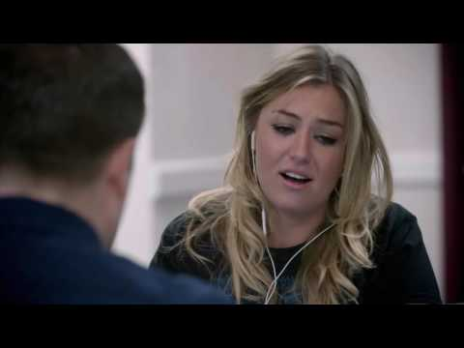

Slide 34
Google yourself!
Common Security Questions:
What street did you grow up on?
What middle school did you attend?
What is your mother’s maiden name?
Who is your childhood best friend?
Notes:
If you were to Google yourself, can you find the answers to these common security questions? Think about what you share publicly on Facebook, Instagram, or Twitter. What about your parents? Do they share information about you on their social media? Has your school posted about you online?

Slide 35
Has your password been breached?
Sometimes websites you use will be hacked and then your information will be online for hackers to use.
Let’s check if I’ve been compromised!
Notes:
Visit HaveIBeenPwned.com
Show myself running a password and looking at the results.
What does this mean? I need to change my password!

Slide 36
164,000,000
Records were exposed due to data breaches in 2019.

Slide 37
What is OSINT?
Open-source intelligence (OSINT) is data collected from publicly available sources to be used in an intelligence context.
Examples:
Your email address
Your date of birth
What company you work for
What bank you use

Slide 38
Spiderfoot OSINT tool
Notes:
Introduce them to an open source OSINT tool (Spiderfoot)

Slide 39
What are some ways that social engineering is abused?
Social engineering can be used to gain credentials, reset your password, or convince you to download malware onto your device.
They combine information with a sense of urgency or intimidation.

Slide 40
How do you identify a scam/phishing email?
You don’t recognize the sender name
The subject line looks like spam
It doesn’t address you by name and instead uses a vague introduction like “Dear customer”
It’s offering something that’s too good to be true
There are grammatical errors
It’s asking for personal information like your full name, phone number or address
There is a suspicious link in the email (don’t click it!) (hover over the link to see where it actually goes. Or “Show original” in gmail to avoid an accidental click)

Slide 41
Identify a Phishing Scam
Notes:
Google Phishing Quiz

Slide 42
Kahoot! Quiz

Slide 43
Launch a Man in the Middle Attack

Slide 44
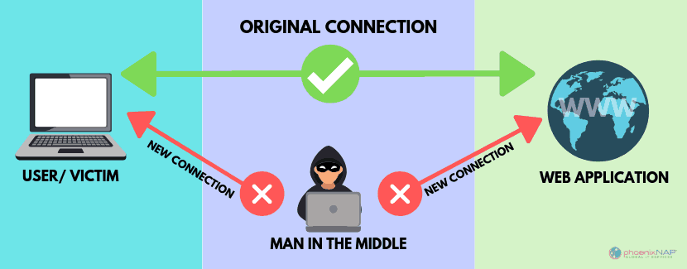
What is a Man in the Middle (MTM) attack?

Slide 45
Types of MTM Attacks
WiFi Eavesdropping: an attacker can watch your actions when you connect to public WiFi
Email Hijacking: an attacker compromises an email account and then silently waits for sensitive information.
IP Spoofing: an attacker mimics the IP address of an authorized device in order to gain access to other devices on the network.

Slide 46
How do you avoid this?
Don’t use public WiFi without a Virtual Private Network.
Be cautious of emails and messages that could be phishing.
Install active virus and malware protection.
Minimize the potential of attacks by signing out unused accounts to invalidate session cookies.
Force encryption by typing https at the beginning: https://www.website.com.

Slide 47
Kahoot! Quiz

Slide 48
Want to know more?
After this session, Victoria from Girl Scouts Citrus will send out an email with some other security resources and a link to these slides.
Exercise caution when downloading software that you have found online.
Remember, it is illegal to try and hack any system that is not your own.

Slide 49
Thank you!

